Slide 1
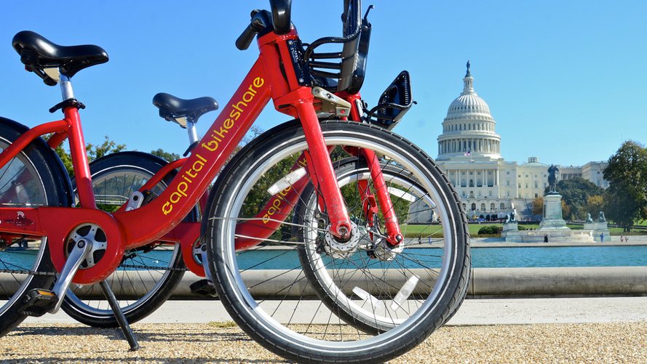

BIKE SHARE SYSTEM PREDICTION
BUSINESS ANALYTICS CAPSTONE PROJECT
By Thanh tu Nguyen
August 17, 2022

Slide 2
Agenda
Executive Summary
Data Analysis and Findings
Modeling
Recommendations
Limitations
Further Work

Slide 3
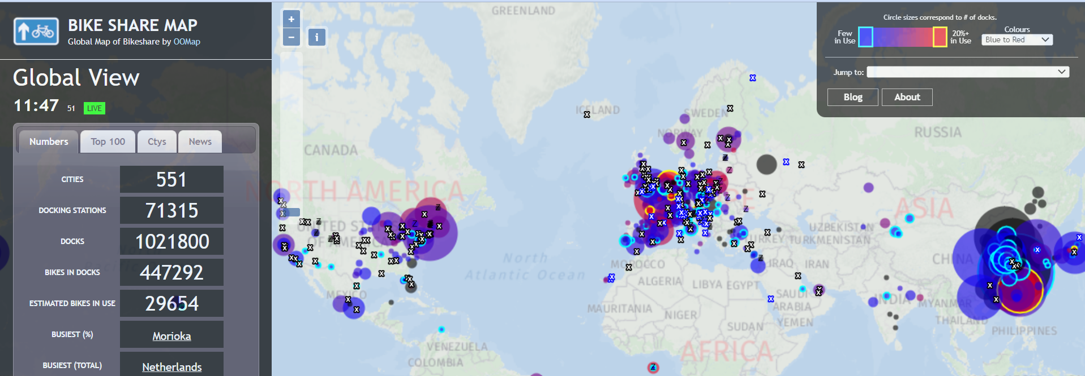
Bikeshare world map
Source: https://bikesharemap.com/#/3/-60/25/

Slide 4
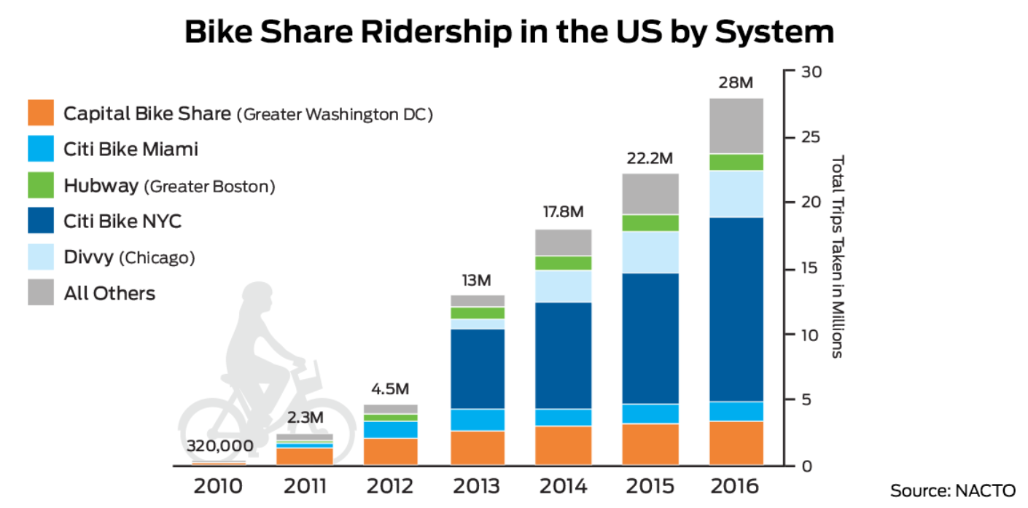

Slide 5


Executive summary
5000+ bikes
600+
stations
07
jurisdictions
Year of 2018
Founded
2010

Slide 6
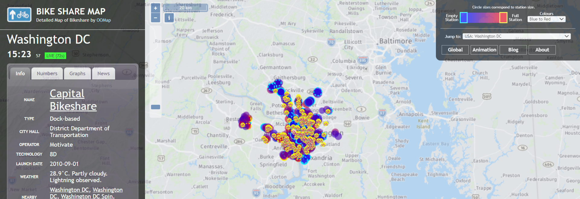
Washington DC bikeshare map
Source: https://bikesharemap.com/washingtondc/#/9/-77.097/38.942/

Slide 7
Objectives
Understanding the environmental factors including weather, season and other data affecting number of casual riders and registered riders of utilizing the dataset collected by Laboratory of Artiﬁcial Intelligence and Decision Support (LIAAD), University of Porto

Slide 8
Data Analysis and Findings
Target variable: count
where count = registered riders + casual riders

Slide 9
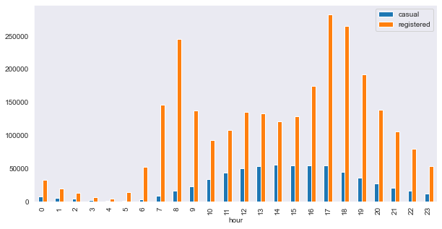
Count of casual and registered riders by hour
Hour | Registered | Casual
8am | 245,240 | 15,761
5pm | 282,640 | 54,220
6pm | 265,276 | 44496
Hour | Registered | Casual
2pm | 120,563 | 55,089
3pm | 128,543 | 54,606
4pm | 173,914 | 53,834

Slide 10



Count of casual and registered riders by weather situation
Registered | Casual
1,780,000 | 480000
Registered | Casual
730,000 | 125,000
Registered | Casual
125,000 | 100,000

Slide 11
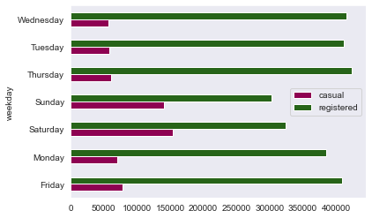
Count of casual and registered riders by weekday

Slide 12

410726 | 60622
715067 | 203522
835038 | 226091
711831 | 129782
Count of casual and registered riders by season

Slide 13
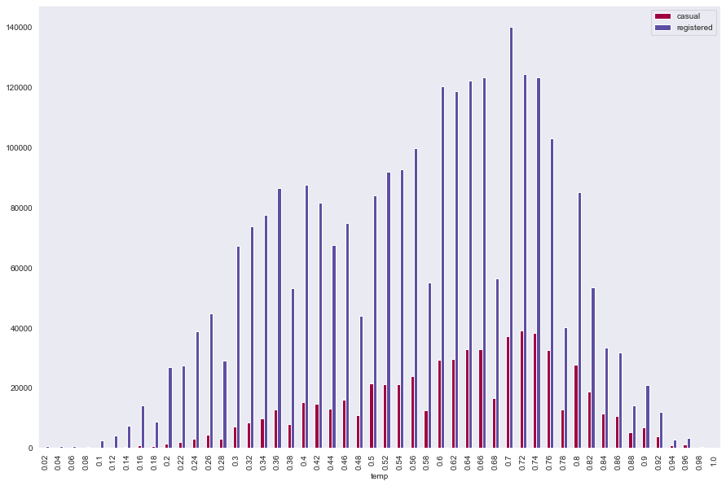
Count of casual and registered riders by temperature

Slide 14

Modeling
Linear Regression
Polynomial Regression
Random Forest

Slide 15
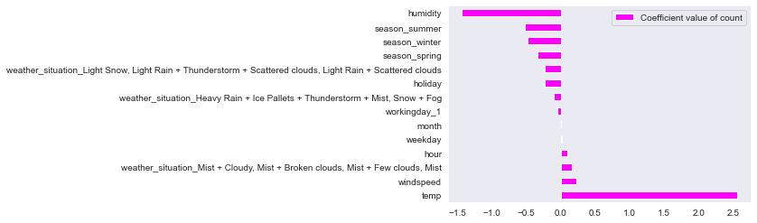
Insight findings of ‘count’

Slide 16
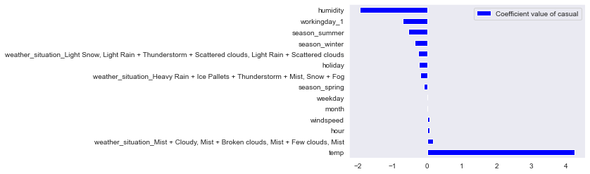
Insight findings of ‘casual’

Slide 17
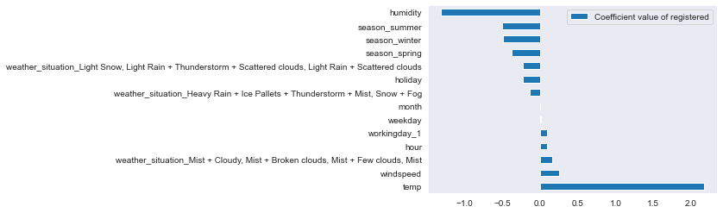
Insight findings of ‘registered’

Slide 18
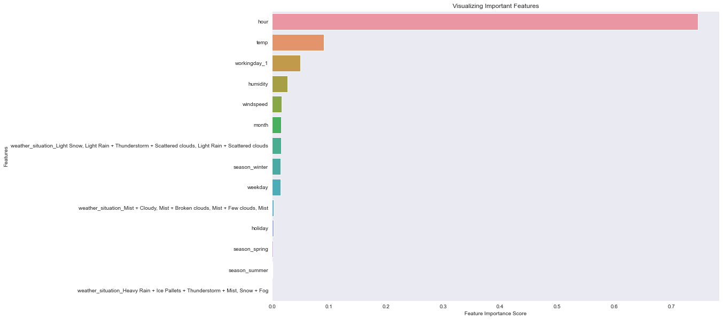
Important feature with ‘count’

Slide 19
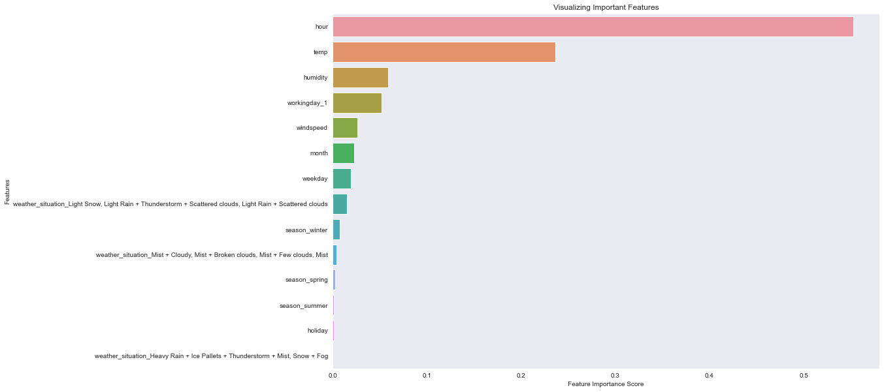
Important features with ‘casual’

Slide 20
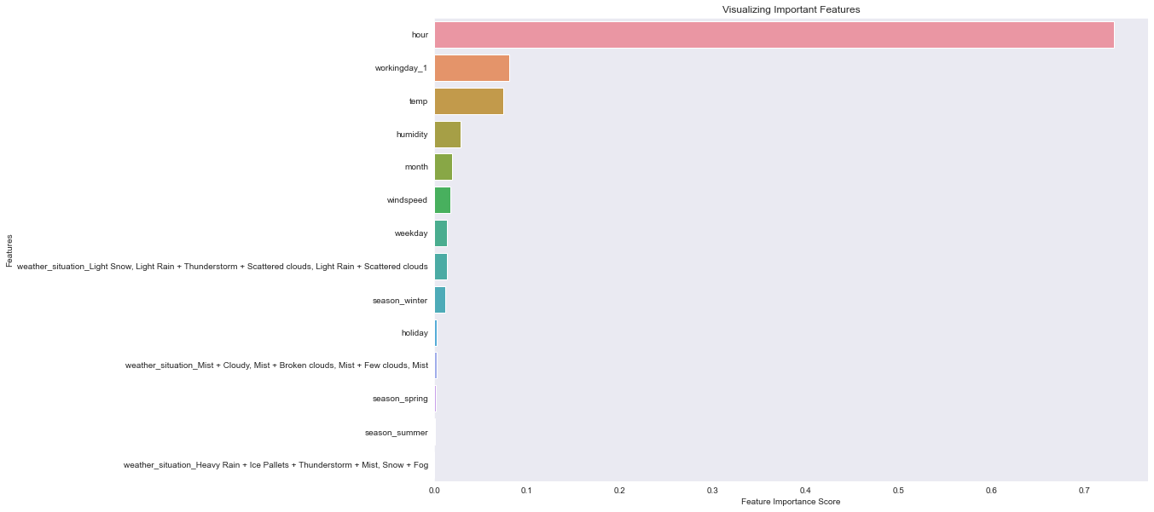
Important features with ‘registered’

Slide 21
Recommendation
Depending temperature and weather situation, Capital Bikeshare should consider refine station performance
Marketing strategies to convert casual riders to registered riders
Encouraging to nonmotorized transportation advocates

Slide 22
Limitations
Biased models
Western vs Eastern
bike share culture
Environmental factors
impacted by demographic and population
climate change and extreme weather events
joint prediction with other transportations
Hidden problems
Gas price
Price of bike sharing
Outdated dataset: 2011-2012
Wealth fitness

Slide 23
Further work
Investigate the geographical information of bike rental docking station locations, or locations of daily vehicle accidents reported
Focus on impact on the changing nature of public transportation systems in urban areas after the pandemic

Slide 24
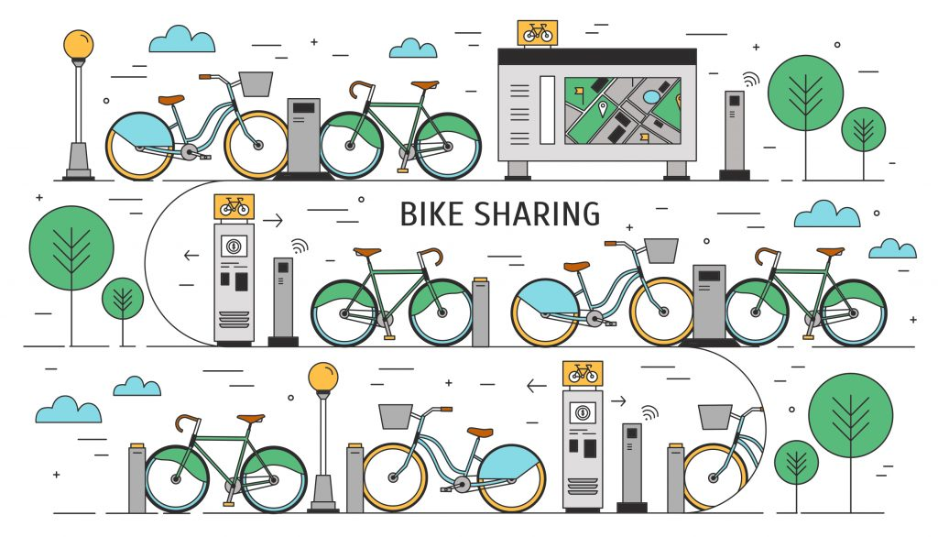
Q&A

